Slide 1
Team Info
TeamTeam Leader Name: Aryan Gupta
Branch (Btech/Mtech/PhD etc): BTech Stream (ECE, CSE etc): IT NS Year (I,II,III,IV): II
Team Member 1 Name: Harshita Varshney
Branch (Btech/Mtech/PhD etc): BTech Stream (ECE, CSE etc): IT NS Year (I,II,III,IV): ||
Team Member 2 Name: Akshit Lalit
Branch (Btech/Mtech/PhD etc): BTech Stream (ECE, CSE etc): IT NS Year (I,II,III,IV): II
Team Member 3 Name: Priyanshi Goel
Branch (Btech/Mtech/PhD etc): BTech Stream (ECE, CSE etc): IT NS Year (I,II,III,IV): II
Team Member 4 Name: Madhur Ahuja
Branch (Btech/Mtech/PhD etc): BTech Stream (ECE, CSE etc): ME Year (I,II,III,IV): II
Team Member 5 Name: Nikhil Vashisht
Branch (Btech/Mtech/PhD etc): Stream (ECE, CSE etc): Year (I,II,III,IV): II

Slide 2


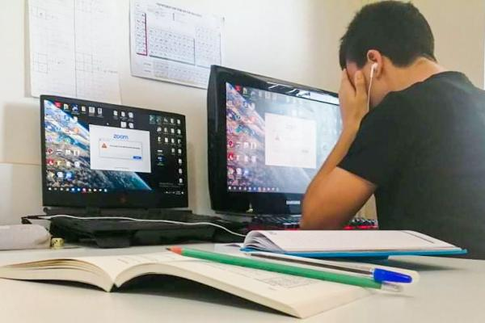
Problem: Shared usage of workshops and labs by all Educational Institutions at National Level
Presently each educational Institution has its workshops and labs that are utilized by the students of that specific Institution.
But in Covid scenario, students are primarily studying in online mode and are often in cities or hometowns away from their respective educational institution.
Hence, students often are unable to practice lab activities which hinders their learning process.
Even in a Non-Covid scenario, sometimes the labs in some institutions lack the facilities required by students. In that scenario, a student is often left helpless.

Slide 3
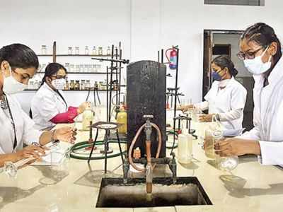
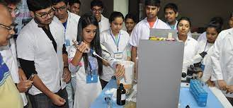
Solution
To facilitate students to utilize the facilities of Institutions closer to their hometowns, labs in Government Institutions could be booked by students for specific job works
The labs could be booked for a certain duration via a web portal at an hourly charge.
This would enable the students to use the lab facilities of institutions near them whenever it wouldn’t be convenient for them to avail the lab facilities of their own institute.
This would enable them to keep working on their project/research with the same zeal.

Slide 4
Market Size
At present, according to the AISHE, the higher education sector in India consists of 3.74 crore students across 993 universities, 39,931 colleges, and 10,725 stand-alone institutions.
2530 people in a crore people are involved in Research and Development in India. These people are also our target audience as these people are very likely to avail laboratory and workshop facilities to aid their jobs/work.
The Indian schooling system is one of the largest in the world and caters to over 25 crore students. These students can become active users of our application.
All these audiences together amount to be around 30 crores, making this market humongous.

Slide 5
Market Validation
The target audience is very responsive, vigilant and active. It is an audience which is well-educated and well versed with technology.
And since, the idea solves a crucial problem, the market is very welcoming of this idea.
Market validation is not a challenge. With proper marketing and awareness, a product like this which solves the problem of crores of students has the potential to add a new dimension to our education system.
Notes:
Goto market- Timeline

Slide 6

Business Model
Our application is very flexible and offers the users multiple models which enables the user to select the one which suits him/her the best and also provides the company with multiple revenue streams.
Pay per Use Model
Subscription Model
Institution based subscription.
Individual based subscription.
Advertisement based revenue
Partnering with product based government agencies.

Slide 7

Competition
Currently, this market is untapped. There is no competition in this space.
This is a novel idea and currently no portal or platform exists which connects users to laboratories/workshops near to their homes. If the idea is selected, our portal could be the first and the only portal a user would need for his/her needs.
Also, this idea is Mainstream. The target audience is massive and the potential in this idea is colossal. This idea has the potential to impact and improve the learning experience of tens of crores of students and researchers.

Slide 8
Financial model and projections
Our application is very flexible and offers the users multiple models which enables the user to select the one which suits him/her the best and also provides the company with multiple revenue streams.
Pay per Use Model
Subscription Model
Institution based subscription.
Individual based subscription.
Advertisement based revenue
Partnering with product based government agencies.
Investment to develop: A team of developers would be required to maintain and update the software. Also, we would require data entry operatiors or lab faculty to update and keep record of the data from and of the institutes on our servers.

Slide 9
Competitive advantages
As mentioned before, the market in untapped and hence, we have the first-mover advantage. Also, in a field like this, there isn’t much scope for many players to co-exist hence, our early strides help us move ahead on the road to a potential access to the majority of the market.
Our strength lies in our novel idea and strong tech to back it up. We aim to create a smooth, simple and east to comprehend user interface that can be accessed by all. This enables us to increase the reach and accessibility of our platform.
Adept security measures protect our platform against threats.
We also have a built-in payment gateway with all the regulatory security protocols for smooth and safe transactions.

Slide 10
Assumptions and risks
Possible risks would be the maintenance cost of the equipment, which would be then too high because of frequent utilization which would be reconsidered by providing an optimum revenue plan so as to maximize the profit.
Another possible risk could be the requirement of lab assistants and staff during the sessions all the time which could possibly hamper our motive.
This risk could be dealt with by providing adequate remuneration to the staff and encourage Universities to appoint more staff to deal with this.
A potential risk is safety and verification. Hence, we will provide the institutes a platform where they can store the details like name, time, duration, etc of all the students who used their facilities.

